Slide 1
Data Perikanan Sang Tombolang
Total landings
CPUE
Size Structure

Slide 2
Total Landings in MAR Bolaang Mongondow
600
400
Total landings(kg)
200
Increased
0
Jun 2024
Sep 2024
Dec 2024
Mar 2025
Jun 2025
Sep 2025

Slide 3
Catch Per Unit Effort in MAR Bolaang Mongondow
200
150
CPUE (kg/fisher/trip)
100
50
Increased
0
Jun 2024
Sep 2024
Dec 2024
Mar 2025
Jun 2025
Sep 2025

Slide 4
Kakap Merah
Lutjanus malabaricus

Slide 5
Total Landings L.malabaricus in MAR Bolaang Mongondow
20
Total landings(kg)
10
Stable
0
Sep 2024
Mar 2025
Sep 2025

Slide 6
Catch Per Unit Effort L.malabaricus in MAR Bolaang Mongondow
20
15
CPUE (kg/fisher/trip)
10
5
Stable
0
Sep 2024
Mar 2025
Sep 2025

Slide 7
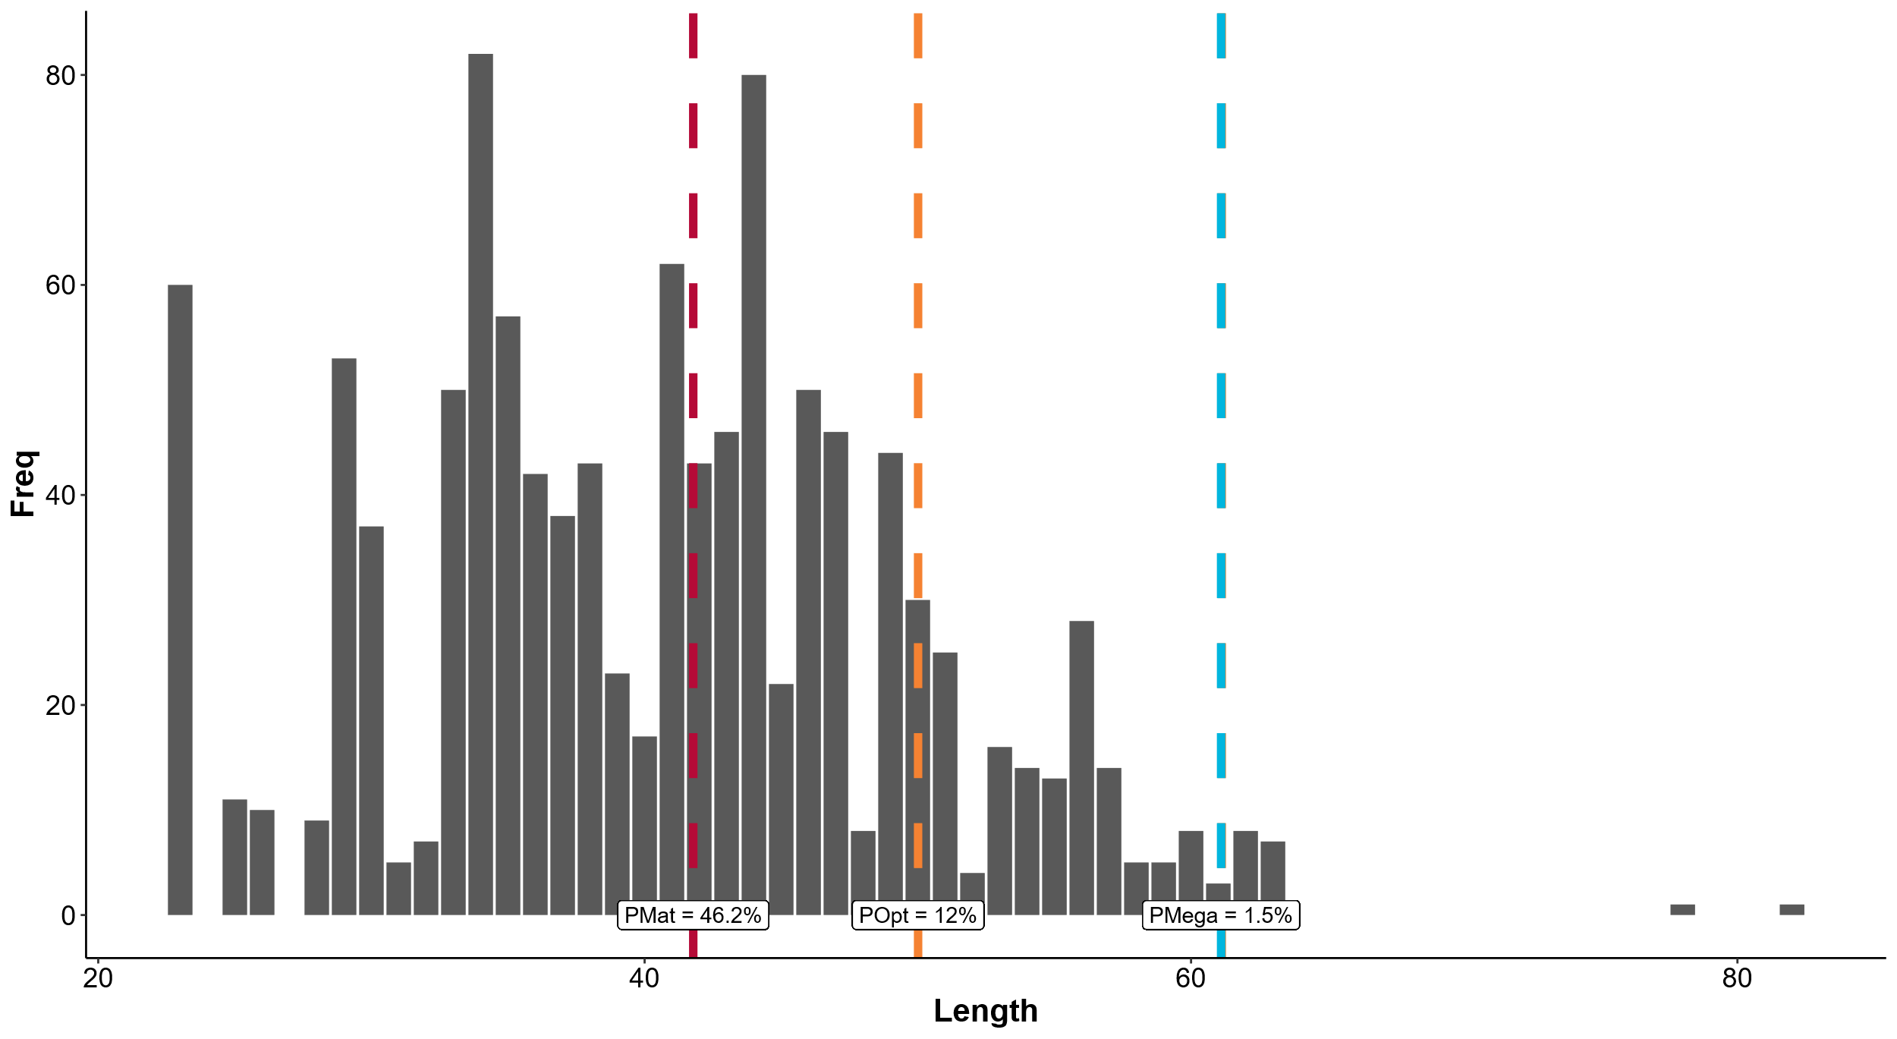

Slide 8
Bobara
Carangoides coeruleopinnatus

Slide 9
Total Landings L.malabaricus in MAR Sang Tombolang
20
Stable
15
Total landings(kg)
10
5
0
Sep 2019
Mar 2020
Sep 2020
Mar 2021
Sep 2021
Mar 2022
Sep 2022
Mar 2023
Sep 2023
Mar 2024
Sep 2024

Slide 10
Fish Functional Diversity
Fish Susceptibility
Livelihood Insecurity Perception
Compared the state of fisheries functional groups’ susceptibility with CCVA’s scores of Livelihood Insecurity Perception
Determine whether they are overestimating, underestimating, or is this an alarmed for them to take action
After grouping into functional groups, identify each species’ Susceptibility
Need weighted (?) calculations to determine each groups value (based on biomass and density)
Calculate the state of fisheries functional groups’ susceptibility towards climate change, based on (2)
Look at Ecological Survey
Look at Fish Transaction
Look at all the fish species, grouping into functional groups

Slide 11
Catch Per Unit Effort L.malabaricus in MAR Sang Tombolang
Stable
6
4
CPUE (kg/fisher/trip)
2
0
Sep 2019
Mar 2020
Sep 2020
Mar 2021
Sep 2021
Mar 2022
Sep 2022
Mar 2023
Sep 2023
Mar 2024
Sep 2024

Slide 12
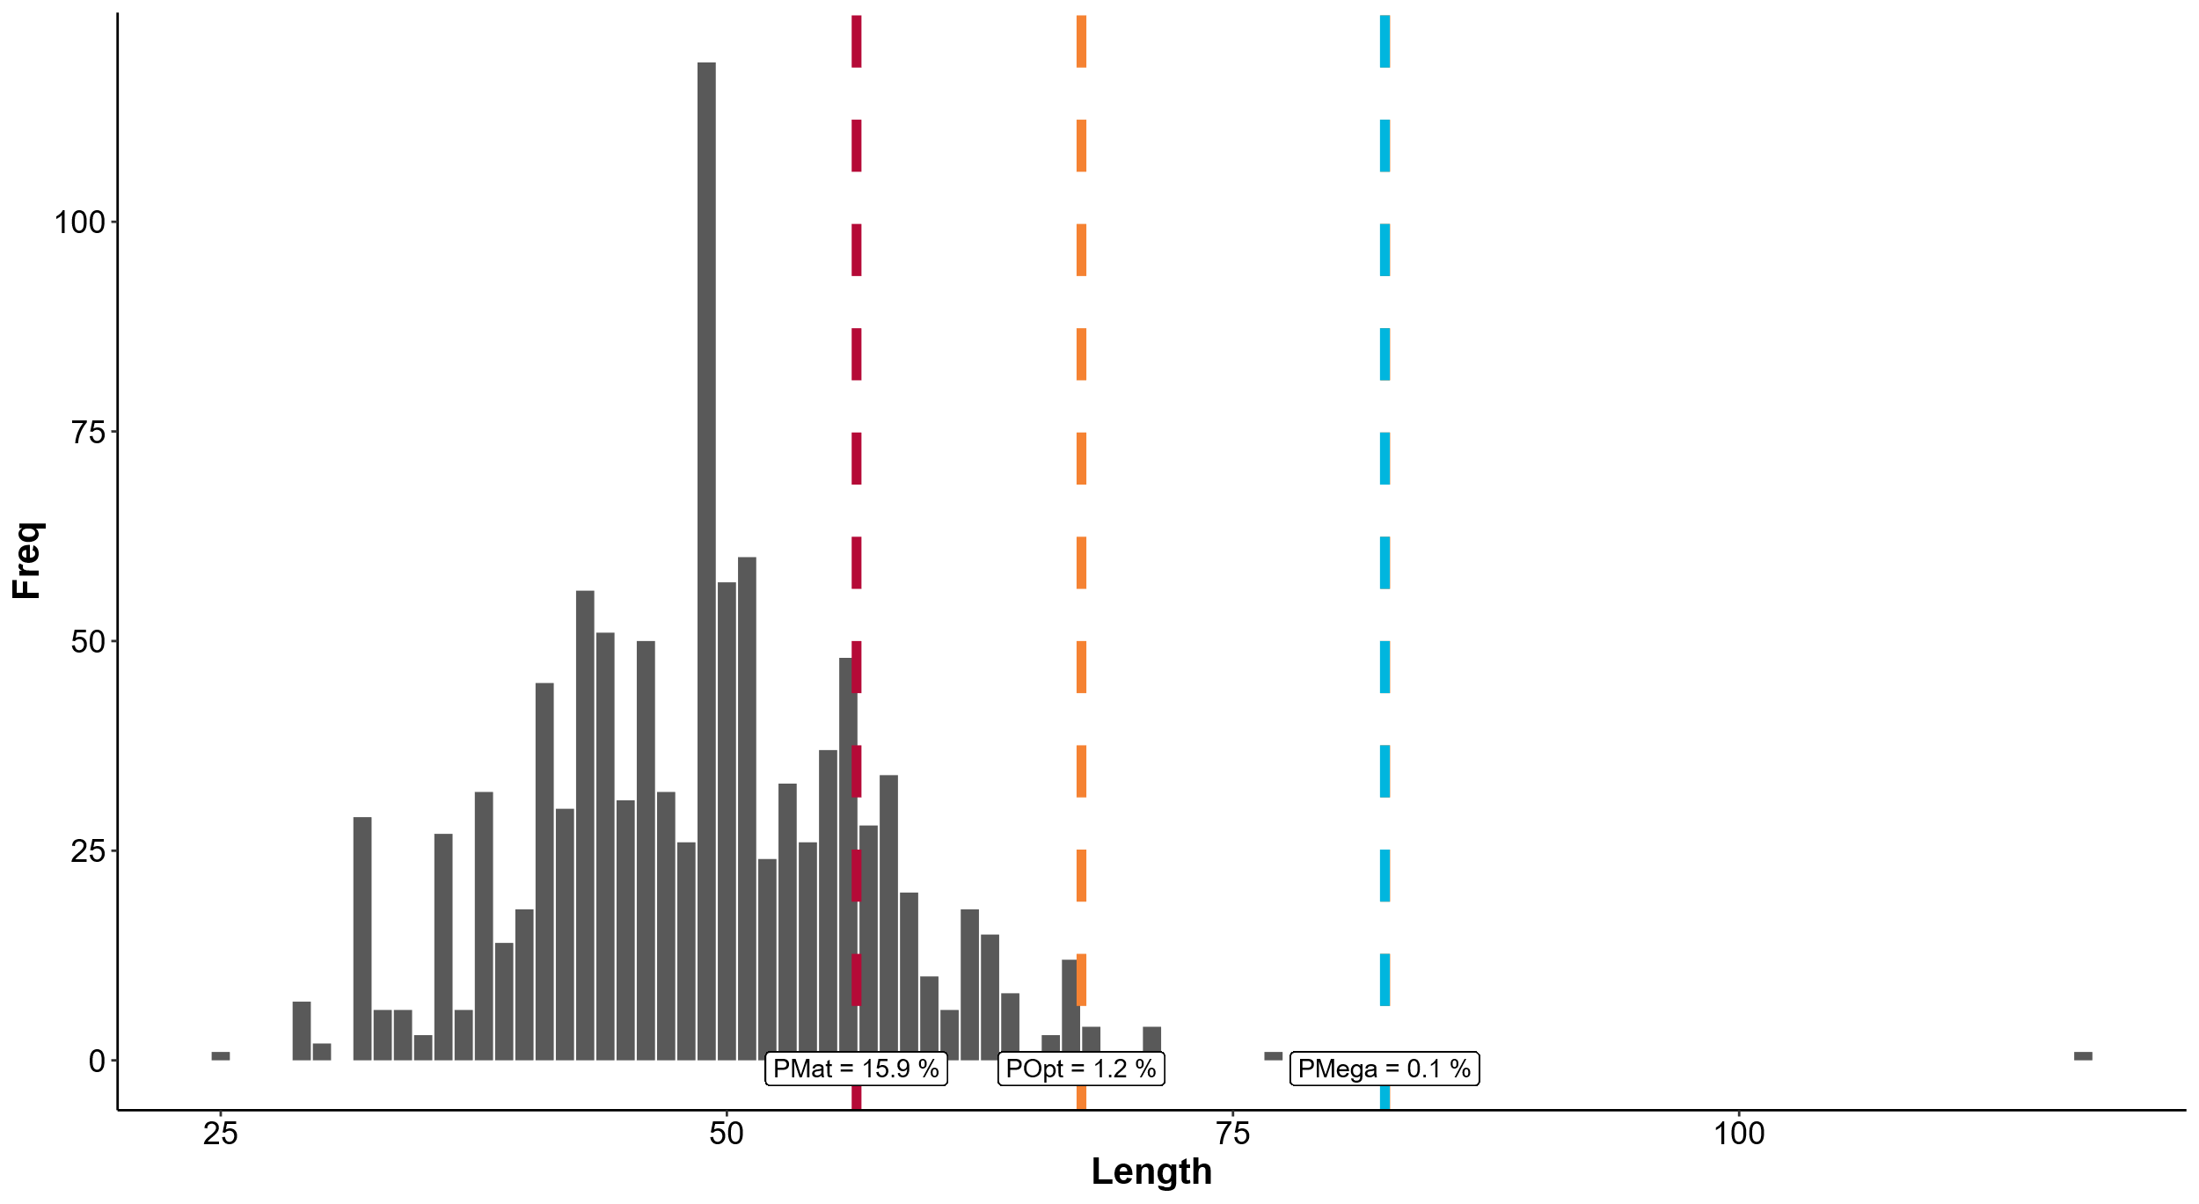

Slide 13
Gurita
Octopus vulgaris

Slide 14
Total Landings O.cyanea in MAR Sang Tombolang
20
Stable
15
Total landings(kg)
10
5
0
Aug 2019
Feb 2020
Aug 2020
Feb 2021
Aug 2021
Feb 2022
Aug 2022
Feb 2023
Aug 2023
Feb 2024
Aug 2024
Feb 2025
Aug 2025

Slide 15
Catch Per Unit Effort O.cyanea in MAR Sang Tombolang
10
CPUE (kg/fisher/trip)
Decreased
5
0
Aug 2019
Feb 2020
Aug 2020
Feb 2021
Aug 2021
Feb 2022
Aug 2022
Feb 2023
Aug 2023
Feb 2024
Aug 2024
Feb 2025
Aug 2025

Slide 16
